Slide 1
DC Biasing – BJTs
Topic 4 (Chapter 4)
(Some materials are from Malvino’s book)

Slide 2
Biasing
Biasing: Applying DC voltages to a transistor in order to turn it on so that it can amplify AC signals.

Slide 3
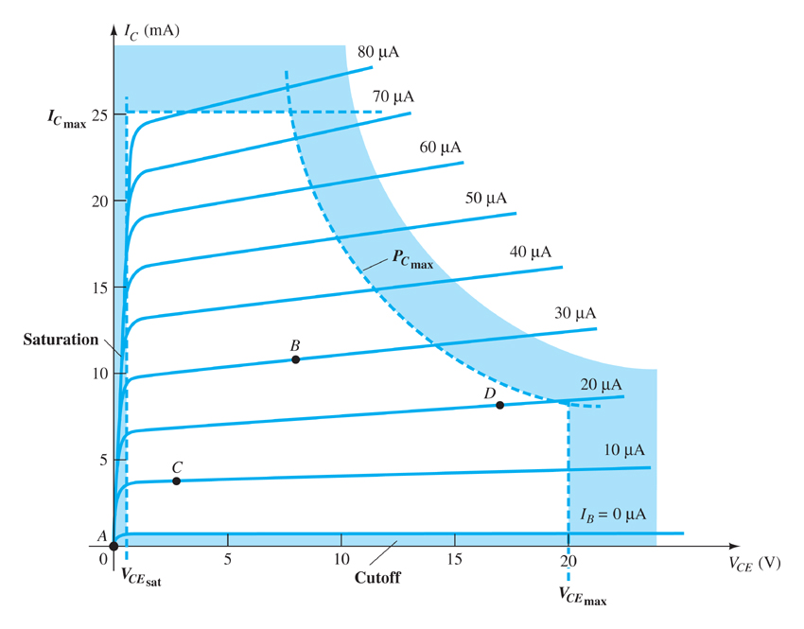
4.2 Operating Point
The DC voltages establishes an operating or quiescent point
called the Q-point.

Slide 4
The Three Operating Regions
    Active or Linear Region Operation
    Base–Emitter junction is forward biased
        Base–Collector junction is reverse biased
        BJT works as an Amplifier
    Cutoff Region Operation
    Base–Emitter junction is reverse biased
    Base–Collector junction is reverse biased
    BJT works as an OFF Switch
    Saturation Region Operation
    Base–Emitter junction is forward biased
    Base–Collector junction is forward biased or near forward bias
    BJT works as an ON Switch

Slide 5
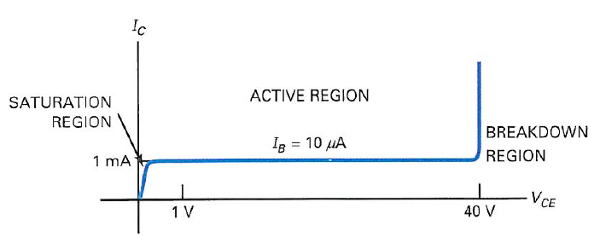
Regions of operation
Cutoff Region
Active - - - used for linear amplification
Cutoff - - - used in switching applications (OFF)
Saturation - - - used in switching applications (ON)
Breakdown - - - can destroy the transistor and should be avoided

Slide 6
DC Biasing Circuits
Fixed-bias or Base-Bias
Emitter Bias
Voltage divider bias circuit
DC bias with voltage feedback

Slide 7
4.3 Base-Bias or Fixed-Bias
Setting up a fixed value of base current
Base current remains constant for given values of V_{BB}
Usually V_{BB} and V_{CC}
are the same supply
1 kΩ
R_{C}
V_{CE}
12 V
V_{CC}
R_{B}
V_{BB}
12 V

Slide 8
Load line
A visual summary of all the possible transistor operating points
Connects saturation current (I_{Csat}) to cutoff voltage (V_{CEcutoff} )

Slide 9
Load line
V_{CC} - V_{CE}
A graph of this equation
produces a load line.
I_{C} =
R_{C}
14
100 μA
12
80 μA
10
60 μA
I_{C} in mA
8
6
40 μA
4
20 μA
2
0 μA
0
2
4
6
8
10
12
14
16
18
V_{CE} in Volts

Slide 10
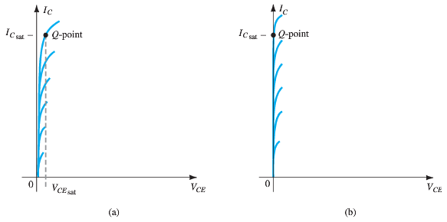
Saturation
When the transistor is operating in saturation, current through the transistor is at its maximum possible value.

Slide 11
Understanding Saturation
12 V
I_{C} =
1 kΩ
1 kΩ
R_{C}
Mental
short
12 V
V_{CC}
R_{B}
V_{BB}
12 V

Slide 12
Understanding Saturation
12 V
This is the
Saturation (maximum) current.
I_{C} =
= 12 mA
1 kΩ
14
100 μA
12
80 μA
10
60 μA
I_{C} in mA
8
6
40 μA
4
20 μA
2
0 μA
0
2
4
6
8
10
12
14
16
18
V_{CE} in Volts

Slide 13
Understanding Cutoff
1 kΩ
R_{C}
Mental
open
12 V
V_{CC}
R_{B}
V_{BB}
12 V

Slide 14
Understanding Cutoff
V_{CE(cutoff)} = V_{CC}
14
100 μA
12
80 μA
10
60 μA
I_{C} in mA
8
6
40 μA
4
20 μA
2
0 μA
0
2
4
6
8
10
12
14
16
18
V_{CE} in Volts

Slide 15

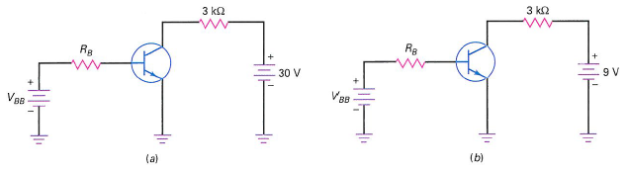
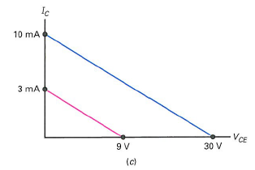

Slide 16
4.4 Emitter bias:
Contains an emitter resistor
1 kΩ
1 kΩ
R_{C}
V_{BB} - V_{BE}
I_{C} ≅ I_{E}
I_{E} =
= 1.95 mA
R_{E}
15 V
V_{CC}
2.2 kΩ
R_{E}
V_{BB}
5 V
V_{C} = 15 V - (1.95 mA)(1 kΩ) = 13.1 V
V_{CE} = 13.1 V - 4.3 V = 8.8 V

Slide 17
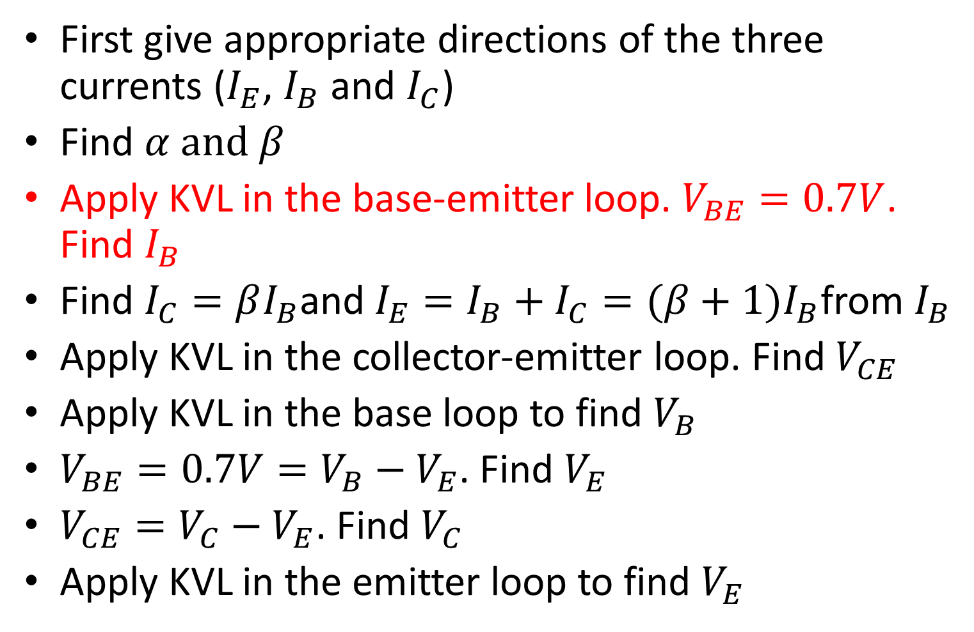
BJT DC biasing
First give appropriate directions of the three currents ($I_{E}$, $I_{B}$ and $I_{C}$)
Find $α and β$
Apply KVL in the base-emitter loop. $V_{BE}=0.7V$. Find $I_{B}$
Find $I_{C}=βI_{B}$and $I_{E}=I_{B}+I_{C}=(β+1)I_{B}$from $I_{B}$
Apply KVL in the collector-emitter loop. Find $V_{CE}$
Apply KVL in the base loop to find $V_{B}$
$V_{BE}=0.7V=V_{B}−V_{E}$. Find $V_{E}$
$V_{CE}=V_{C}−V_{E}$. Find $V_{C}$
Apply KVL in the emitter loop to find $V_{E}$

Slide 18
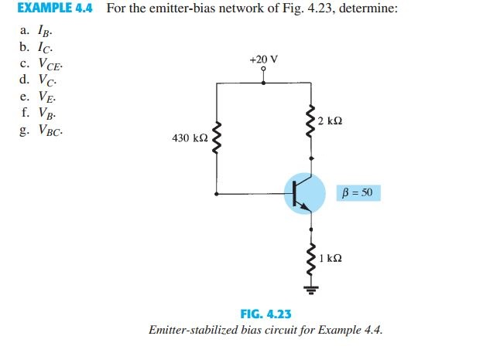
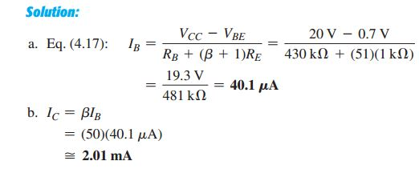
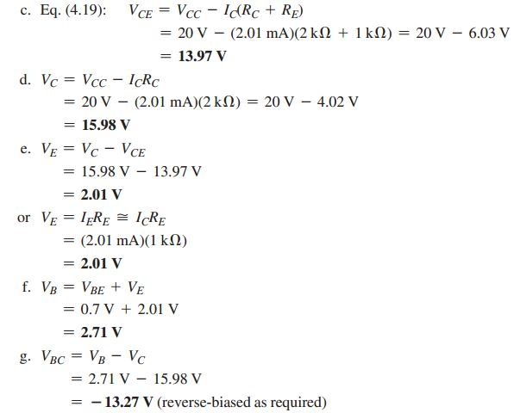

Slide 20
4.5 Voltage divider bias
+V_{CC}
Base circuit contains a voltage divider
Most widely used
Known as VDB
R_{C}
R₁
R₂
R_{E}

Slide 21
Voltage divider bias circuit
{
+V_{CC}
R_{C}
R₁
R₁ and R₂ form
a voltage divider
R₂
R_{E}

Slide 22
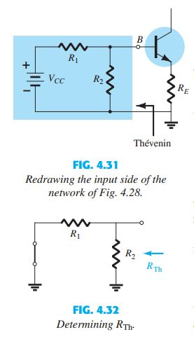
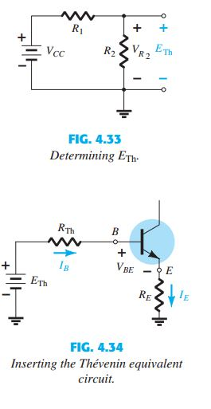

Divider analysis:
R_{th} = R₁ || R₂
E_{th} =
R₂
V_{CC}
R₁ + R₂

Slide 23
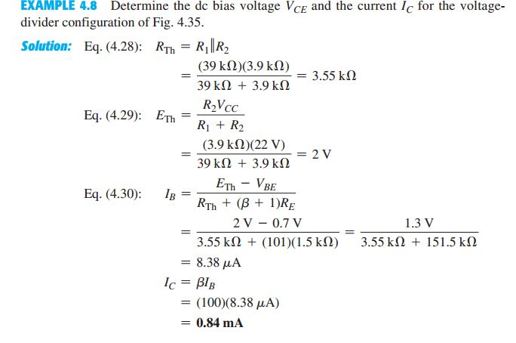
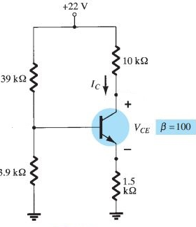
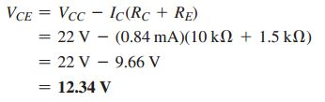

Slide 24
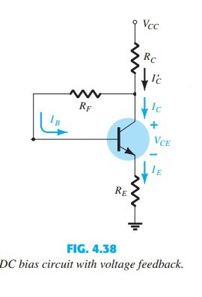
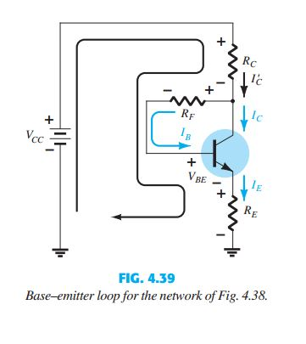

4.6 Collector-feedback bias
Our text calls it DC Bias With Voltage Feedback
Current through $R_{C}=I_{R_{C}}=I_{C^{′}}$
$$I_{C^{′}}=I_{C}+I_{B}$$

Slide 25
